Slide 1
Broadcasting

Slide 2
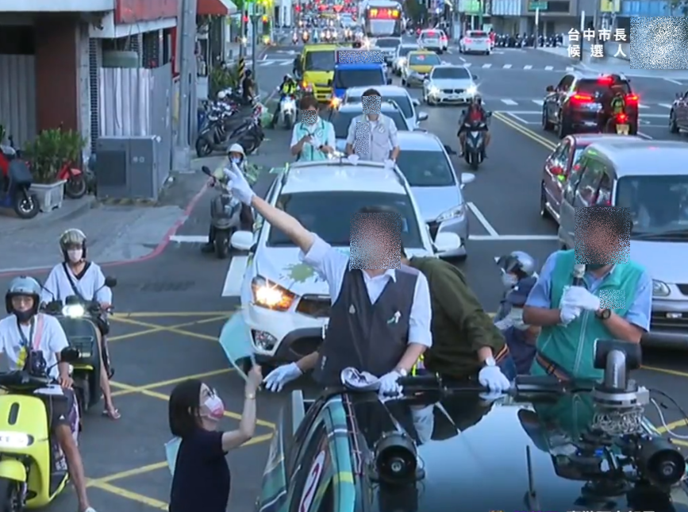
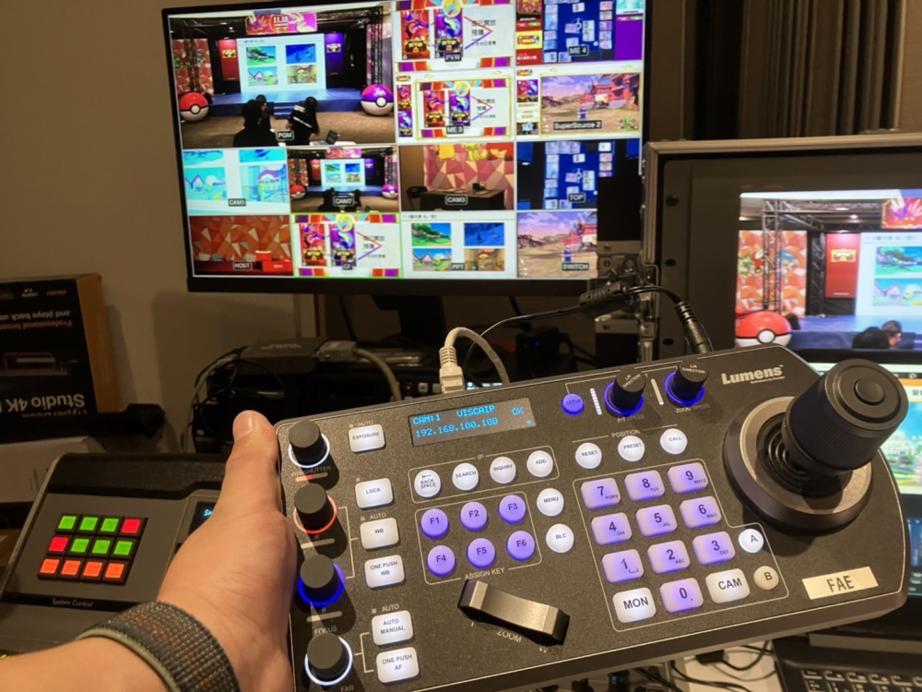
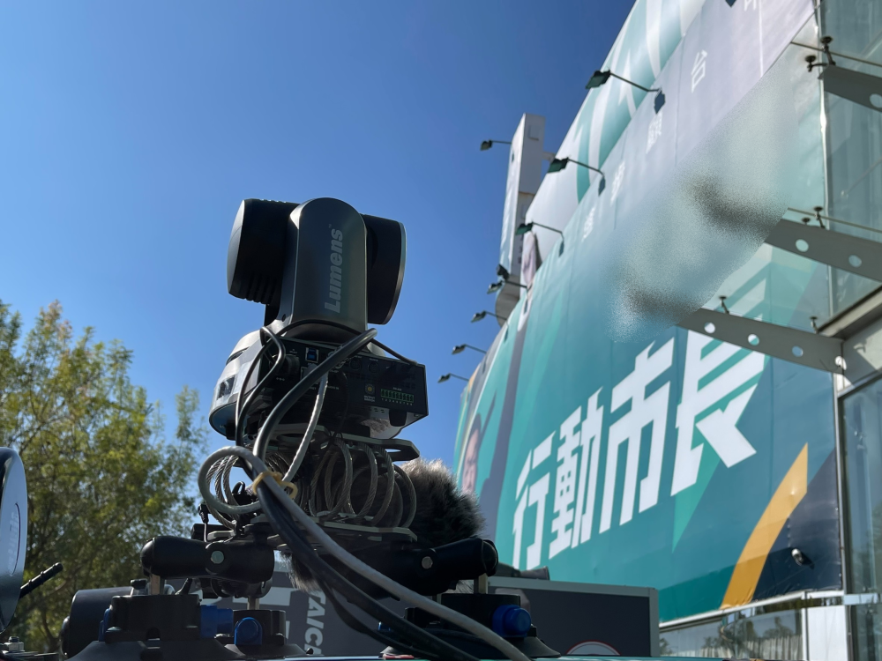
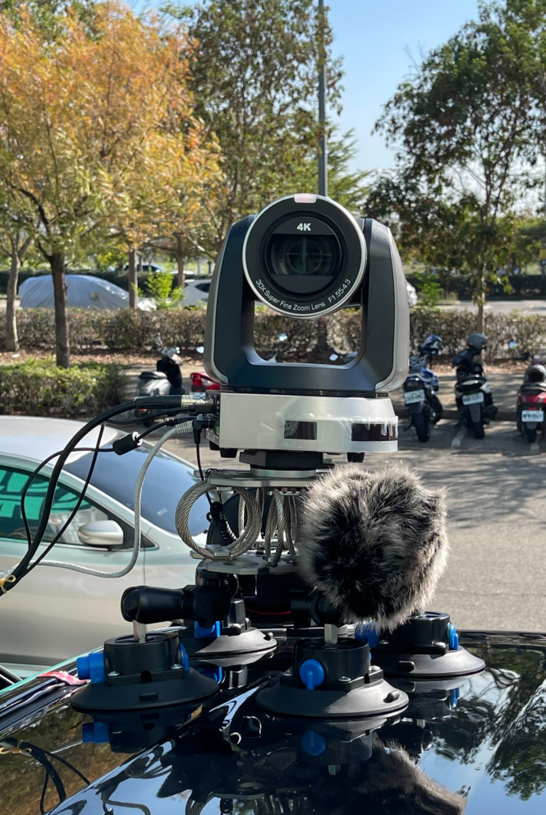
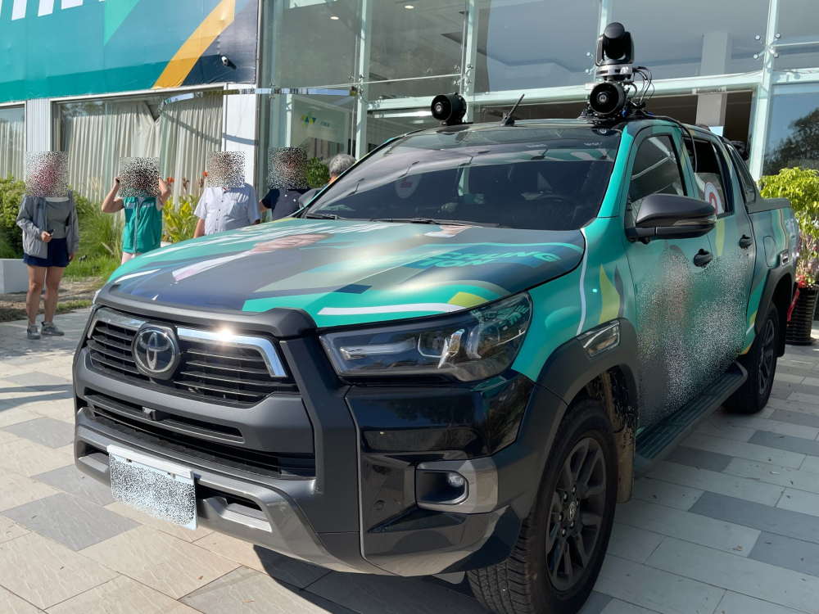
Election Canvass Broadcasting Taiwan
Success Stories
Broadcasting
Product: VC-A71P, VS-KB30
Lumens and Bohemia jointly created a new form of live streaming solution for the canvass activity by using two Lumens 4K PTZ cameras combined with 5G signal transmitters to achieve remote control for filming. The PTZ camera installed on the leading vehicle is responsible for taking a panoramic view of the interaction between the candidates and the public while the camera on the publicity vehicle mainly takes close-up pictures of candidates.
The cameras send the images to the remote campaign headquarters in real time for editing and then uploading to online platforms for live streaming. The photographers also can control the PTZ cameras in real-time through Lumens VS-KB30 control panel, which simplifies the canvass filming closely and the post-production process. They can finish all work remotely in the campaign headquarter.
“The document camera provides our lectures a fantastic opportunity to show physical documents to the class and is often used as a whiteboard function. Overall, we have always found that the Lumens document cameras are easy to use, reliable, of sturdy construction and produce very professional results” — Jul., 2019
Customer Testimonial

Slide 3
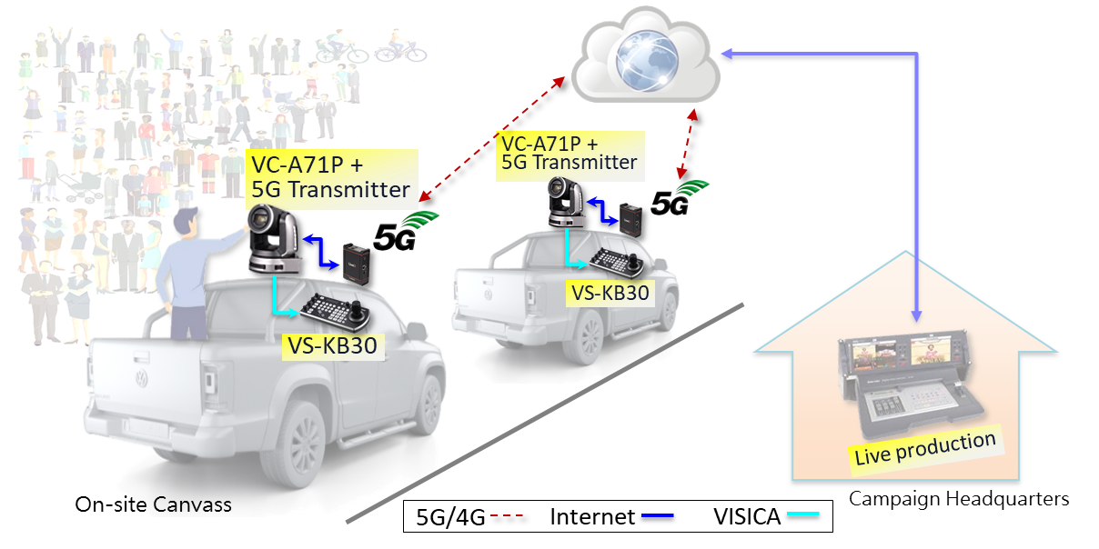
Election Canvass Broadcasting Taiwan
Success Stories
Broadcasting
Product: VC-A71P, VS-KB30

Slide 4
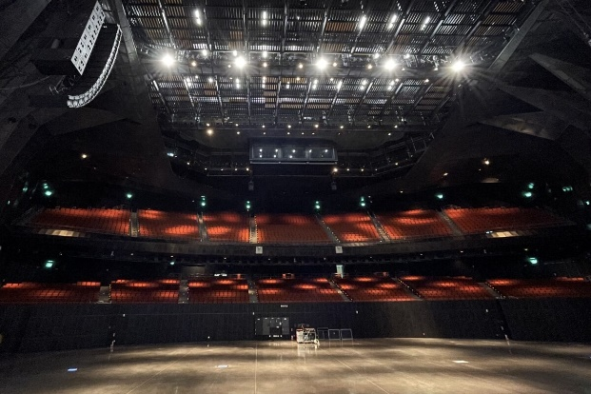
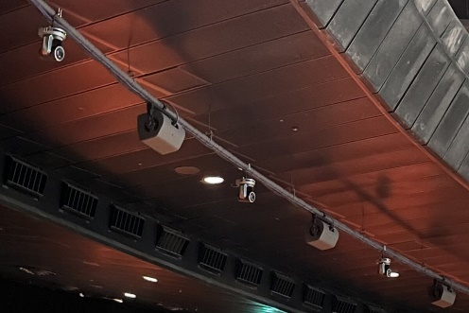
MoonShine Animation
Taiwan
Success Stories
Broadcasting
The NDI rig gives the production team enormous flexibility. By installing robotic, remotely controlled PTZ cameras, the producers can move each camera independently if required to capture any position on the stage. This means that as well as positioning the 16 cameras as a synchronized arc for bullet time production, the crew can take full control of the rig to direct a traditional multi-cam shoot. The VC-A71PN cameras can be controlled via MoonShine's software, or using the Lumens VS-KB30 hardware unit, an intuitive and tactile camera interface which many camera operators prefer for live production.
Product: VC-A71PN, VS-KB30
MoonShine's most recent project was driven by a spirit of experimentation and a commitment to equity. The concept was to install a bullet time rig with free view-point live production system in Taipei Music Center, Taiwan, which would empower viewers to produce their own viewing experience on their own consumer devices.
“Lumens VC-A71PN PTZ camera supports NDI and PoE. It can be powered, imaged, and controlled through a network connection, which is very convenient for the installers. We positioned the camera 30 meters away from the stage. Featuring a 30x optical zoom, we can capture all the performers on stage. The VC-A71PN provides 4K image quality, and it performs well even in a low-light environment. VC-A71PN can effortlessly integrate into the free view-point video recording system with NDI transmission technology. Lumens also provides timely technical support, allowing us to undertake multiple shoots without issue.”
Ted,
MoonShine Animation's System Integration Engineer

Slide 5
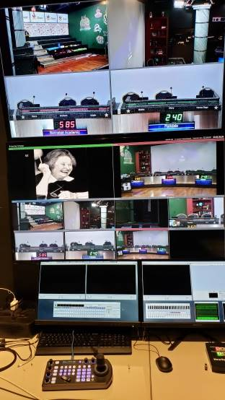
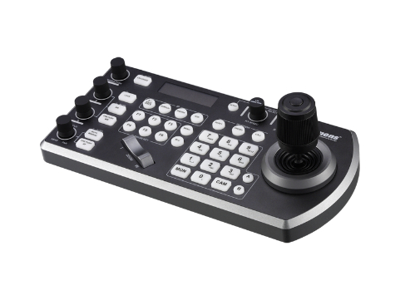
World MediaNet Studios
USA
Success Stories
Broadcasting
Product: VS-KB30
World MediaNet, the television broadcast and recording studio recently add eight robotic cameras to the operation. One VS-KB30 provides a solution that can operate those 8 cameras for TV production. The 8 cameras were daisy chained and then connected to the VS-KB30 via the RS232 port. The installation was easy, the crew were able to operate the cameras right away.
“The Lumens VS-KB30 is very intuitive and easy to lear and to operate”
“The installation was very easy. We were up and running very quickly”
“I have been operating robotic cameras professionally for 22 years. The lumens VS-KB30 is as good as any remote control panelI’ve ever used. The quality and the cost of the Lumens line of products is also attractive. I look forward to getting more Lumens products as our business expands into podcasting productions, sound booth recording, and live shot-flash studio production.”
Studio Production Crew

Slide 6
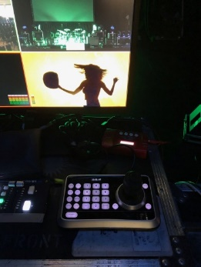
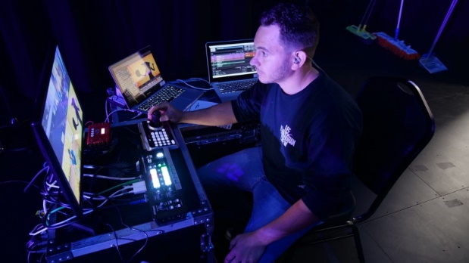
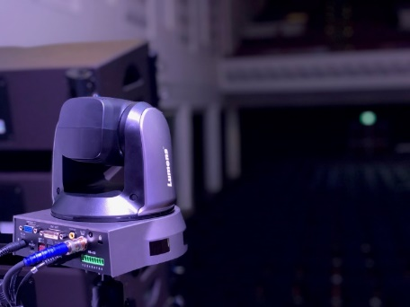
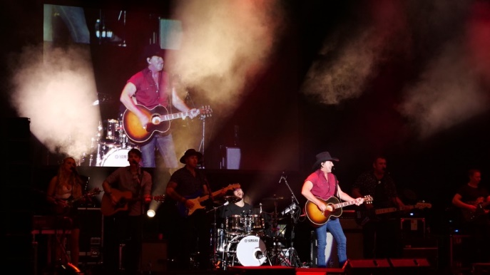
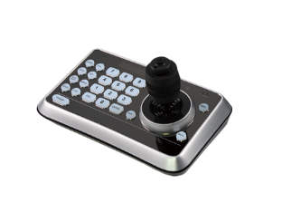
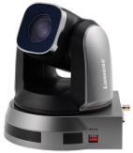
Lee Kernaghan “Backroad Nation” Tour
Australia
Success Stories
Broadcasting
Product: VC-A60S, VS-K20
Lee Kernaghan is Australian country music royalty and one of the hardest musicians in the country. Lee has been out most of 2019 supporting his 15th Studio album, “Backroad Nation.”
Two A60S cameras play a key role in the video production. One is mounted on a tripod and positioned at the back of the room while the second is side of stage on a tripod.
The producer uses the VS-K20 joystick controller for controlling the PTZ cameras and a compact Roland V-1SDI video switcher to call the shots
“I selected the Lumens A60S cameras because they’re great in low light. While the powerful optical and digital zoom means I can place one of the cameras at the back of the room and still get a great, tight shot. Not many tours can afford the cost of extra personnel to stand behind cameras, while I can control two cameras and, thanks to the pan tilt, and zoom control, I can get the shots I need. The fact Lumens image quality is excellent completes the picture”
Studio Production Crew

Slide 7
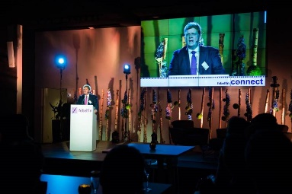
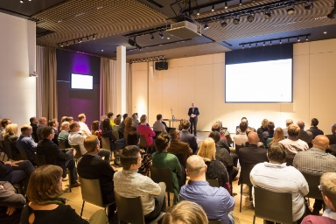
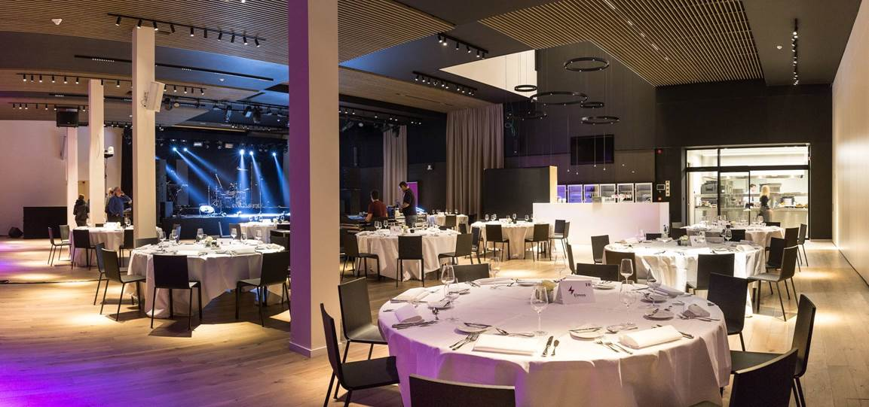
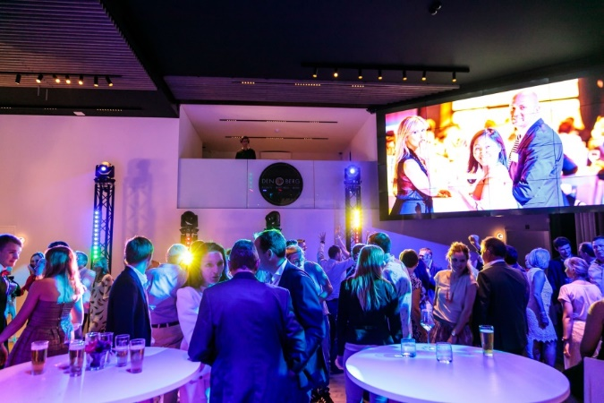
Venue Den Berg
Beigium
Success Stories
Broadcasting
Product: VC-A50P
Four VC-A50P are installed to capture the whole venue and connect to the LED walls and projectors.
During the events, cameras are used to provide live video on LED walls and projectors, at the same time, to stream the event to the whole world with a push of one button.
Power and camera control are all over Ethernet connection.
“The cameras from Lumens enable us to enhance the experience of our customers and give them an easy and affordable memory of the event afterwards. Also, we can host a lot more types of events which need all of this technical equipment”
Events Den Burg

Slide 8
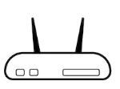
Venue Den Berg
Beigium
Success Stories
Broadcasting
Product: VC-A50P
Lumens PTZ Camera
VC-A50P
Control Over IP
SDI
Ethernet
Ethernet
Camera Controller
Video Switcher
SDI
SDI
Ethernet
PoE Switch
SDI
SDI
Ethernet
Ethernet
SDI
SDI
Network Device
Ethernet
Streaming
Ethernet
PC

Slide 9
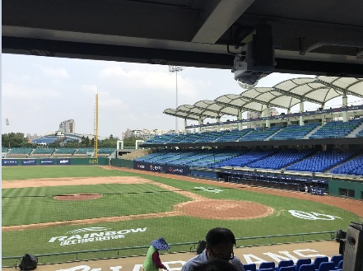
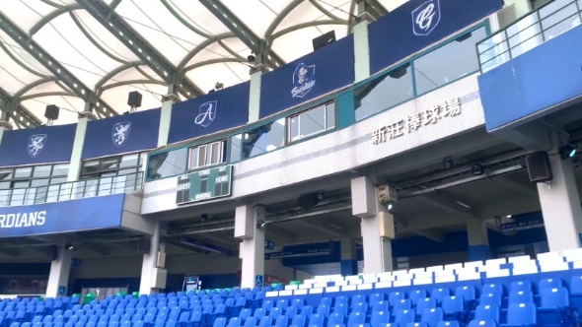
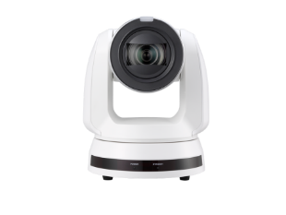
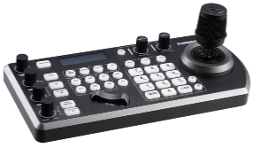
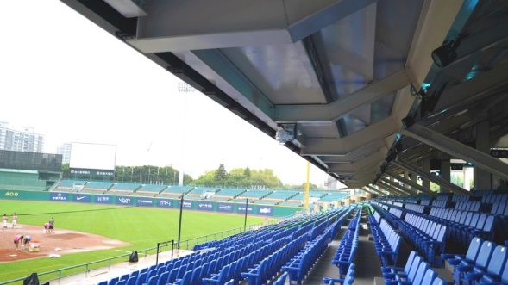
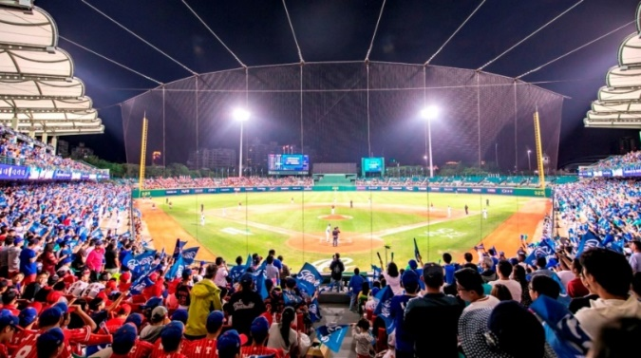
Xinzhuang Baseball Stadium
Taiwan
Success Stories
Broadcasting
Product: VC-A70H, VS-KB30
VC-A70H are used to capture broadcasting room, cheerleaders, fans reaction, and baseball field, especially first base cases with 4K Ultra high definition video.
Camera Controller VS-KB30 is used to control Pan tilt zoom of VC-A70H, store presets in the camera, and call presets for fast switching.
“4K Ultra HD video quality is exactly what KBRO TV looking for. Preset function allows me to fast switch to the scene I need, and joystick is very easy and smooth to control multiple cameras just by one machine.”
Mr. Qian
Broadcasting director at KBRO TV

Slide 10
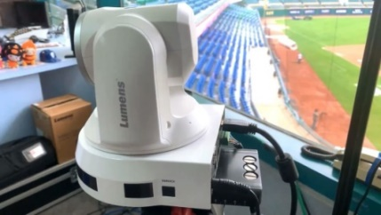
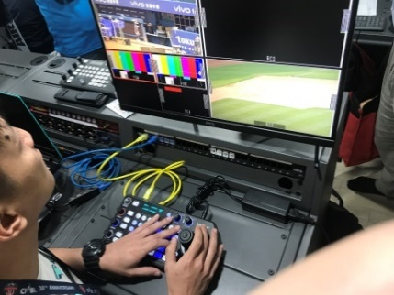
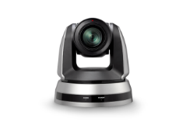
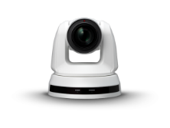
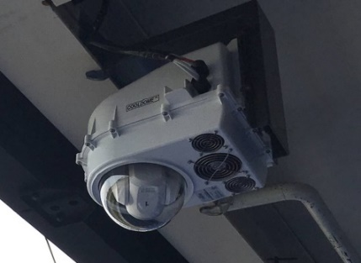
Xinzhuang Baseball Stadium
Taiwan
Success Stories
Broadcasting
Product: VC-A70H, VS-KB30
Lumens IP Controller
VS-KB30
SDI converter
HDMI
HDMI
Lumens PTZ Camera
VC-A70H
HDMI
RS422
SDI
SDI
SDI
Network Repeater
RS422
RS422
RS422
Video Switcher
Ethernet
Ethernet
Ethernet
RS422 converter
Monitor

Slide 11
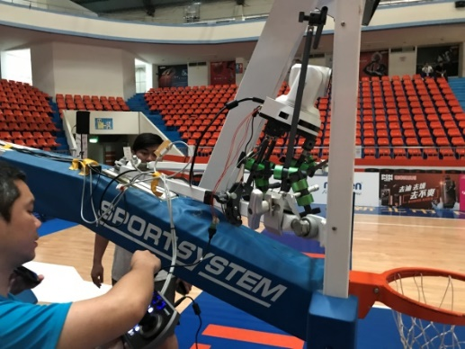
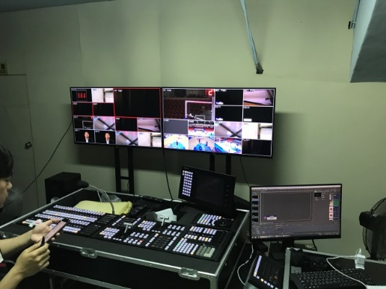
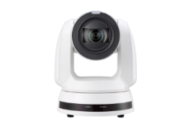
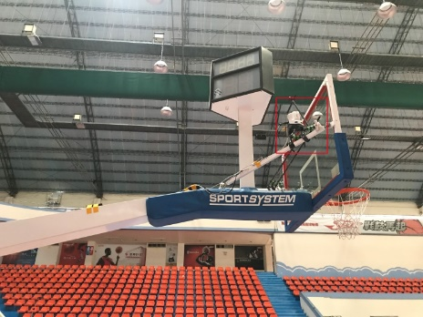
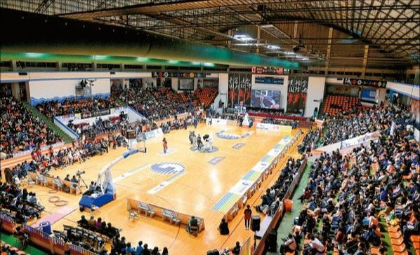
Banqiao Basketball Stadium
Taiwan
Success Stories
Broadcasting
Product: VC-A70H, VS-KB30
Two VC-A70H are installed behind each backboard. They are used for slam dunks, rebounding, and any actions above the rim.
One VC-A70H are used to capture fans reaction and players performance on the basketball field
Camera Controller VS-KB30 is used to control Pan tilt zoom of VC-A70H, store presets in the camera, and call presets for fast switching.
“4K Ultra HD video quality is exactly what KBRO TV looking for. ”
“The motorized pan-tilt base of the camera is very stable even when players shoot the ball.“
Mr. Qian
Broadcasting director at KBRO TV

Slide 12
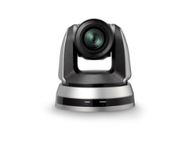
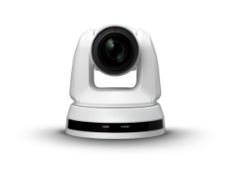
Banqiao Basketball Stadium
Taiwan
Success Stories
Broadcasting
Product: VC-A70H, VS-KB30
DVI converter
HDMI
HDMI
HDMI
Lumens PTZ Camera
VC-A70H
DVI
DVI
DVI
RS422 Daisy Chain
RS422
Video Switcher
Lumens IP Controller
VS-KB30
Monitor

Slide 13
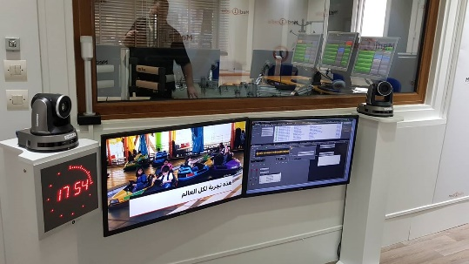
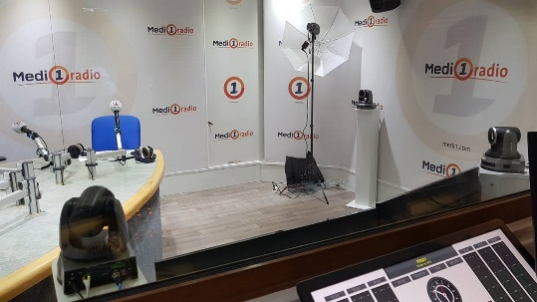
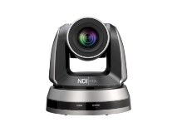
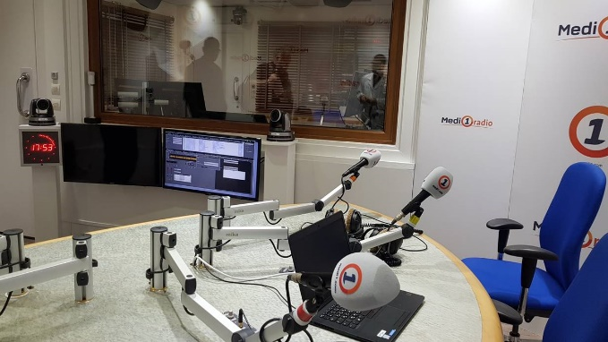
Medi 1 radio
Morocco
Success Stories
Broadcasting
Product: VC-A50PN
Hi-Tech Media specializing in multimedia solutions has installed VC-A50PN for Medi 1 radio for the purpose of web TV shows .
VC-A50PN SDI interface allows long distance installation and control remotely in the operation room
VC-A50PN multiple output interface enables the flexibility of integration into audio/video systems and the installation of different distances and places
“Love the quality and stability of Lumens cameras, and it’s also a complement product for NewTek solutions. I look forward to long-lasting collaboration & partnership with Lumens”
Hakim Masbahi
General Manger at Hi Tech Media Morocco

Slide 14
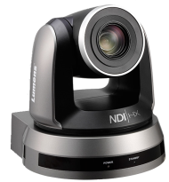
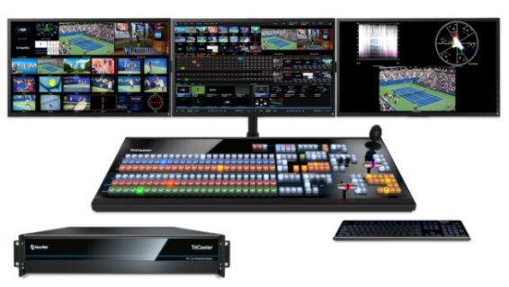
Medi 1 radio
Morocco
Success Stories
Broadcasting
Product: VC-A50PN
Cat 5e
Cat 5e
Lumens PTZ Camera
VC-A50PN
SDI
SDI
Monitor
Monitor
NDI®|HX
NDI®|HX
LAN / WAN
Audio
Cat 5e
Audio
Web TV
NewTek Tricaster

